Slide 1
Strings
Section 2
Chapter 2

Slide 2
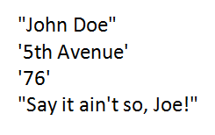
String Literals
Sequence of characters that is treated as a single item
Written as a sequence of characters surrounded by either single quotes (') or double quotes (").
Opening and closing quotation marks must be the same type

Slide 3
String Variables
Variables also can be assigned string values
Created (come into existence) the first time they appear in assignment statements
When an argument of a print statement
Quotation marks not included in display

Slide 4
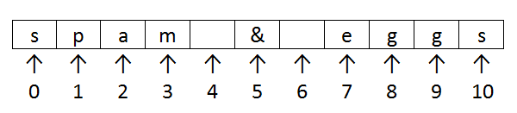
Indices and Slices
Position or index of a character in a string
Identified with one of the numbers 0, 1, 2, 3, . . . .
FIGURE 2.4 Indices of the characters of the string "spam & eggs".

Slide 5
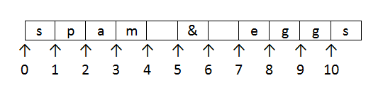
Indices and Slices
If str1 is a string, then str1[m:n] is the substring beginning at position m and ending at position n - 1
Example “spam & eggs”[2:7]
FIGURE 2.5 Aid to visualizing slices.

Slide 6
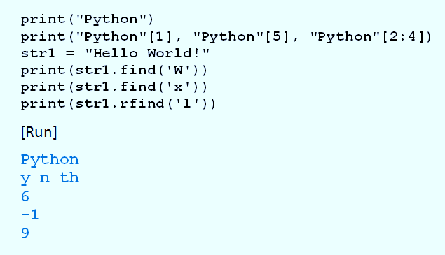
Indices and Slices
Example 1: Program shows use of indices

Slide 7
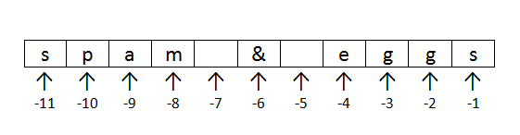
Negative Indices
Python allows strings to be indexed by their position with regards to the right
Use negative numbers for indices.
FIGURE 2.6 Negative indices of the characters of the string "spam & eggs".

Slide 8
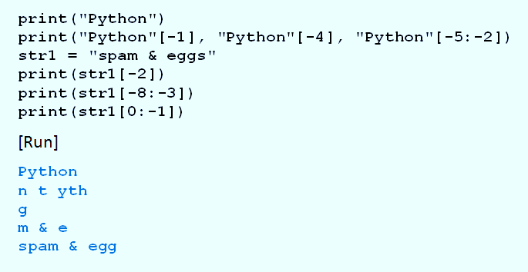
Negative Indices
Example 2: Program illustrates negative indices.

Slide 9
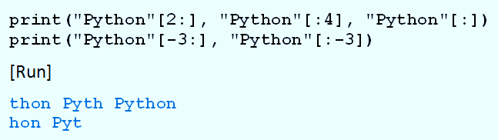
Default Bounds for Slices
Example 3: Program illustrates default bounds

Slide 10
String Concatenation
Two strings can be combined to form a new string
Consisting of the strings joined together
Represented by a plus sign
Combination of strings, plus signs, functions, and methods can be evaluated
Called a string expression

Slide 11
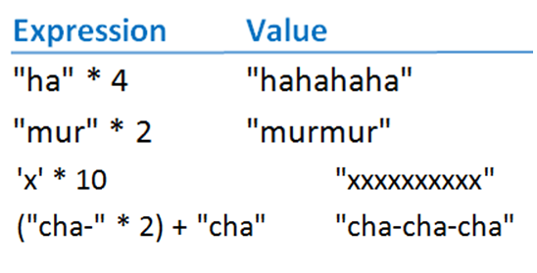
String Repetition
Asterisk operator can be used with strings to repeatedly concatenate a string with itself

Slide 12
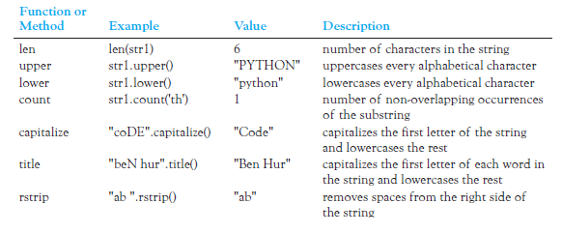
String Functions and Methods
Table 2.3 String Operations (str1 = "Python")

Slide 13

Chained Methods
Lines can be combined into a single line said to chain the two methods
Executed from left to right

Slide 14
The input Function
Prompts the user to enter data
User types response, presses ENTER key
Entry assigned to variable on left

Slide 15
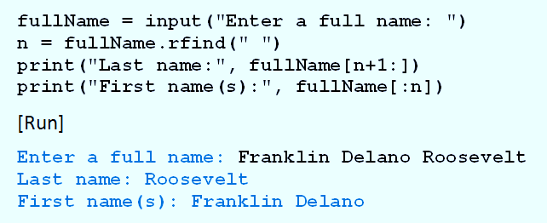
The input Function
Example 4: Program parses a name

Slide 16
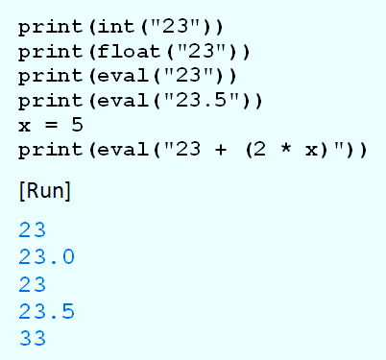
More String Functions
Example 5: Program shows use of int, float, and eval functions

Slide 17
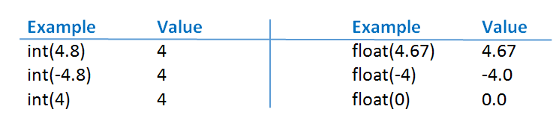
String Functions with Numbers
int and float also work with numbers
The str function converts a number to its string representation
-

Slide 18
Internal Documentation
Benefits of documentation
Other people easily understand program.
You can better understand program when you read it later.
Long programs are easier to read
Purposes of individual pieces can be determined at a glance.

Slide 19
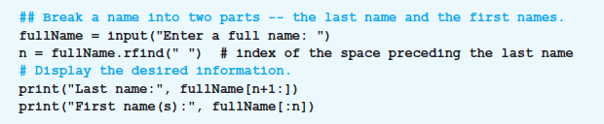
Internal Documentation
Example 6: Program shows use of documentation.

Slide 20

Line Continuation
A long statement can be split across two or more lines
End each line with backslash character ( \ )
Alternatively any code enclosed in a pair of parentheses can span multiple lines.
This is preferred style for most Python programmers

Slide 21
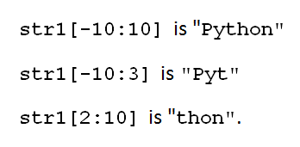
Indexing and Slicing Out of Bounds
Python does not allow out of bounds indexing for individual characters of strings
Does allow out of bounds indices for slices
Given: str1 = “Python”
Then print(str1[7]) print(str1[-7])
These are OK

Slide 22
End
Section 2
Chapter 2

